Slide 1
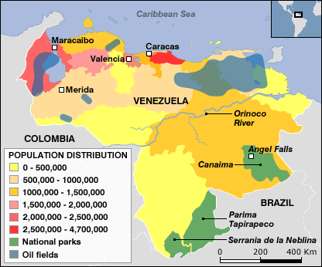
Latin America and the Caribbean Economic Characteristics
Bringenberg
WG 4

Slide 2
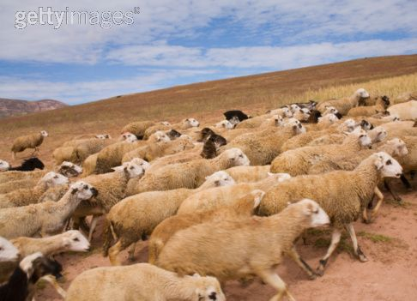
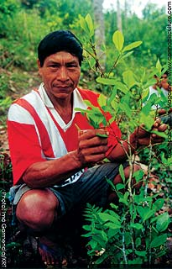
Diverse economies that rely heavily on primary economic activity such as:
Agriculture
Livestock ranching
Plantation agriculture
Slash and burn agriculture
Cash crops ($$$$) and food crops
Cocoa
Coffee
Sugar
Palm oil

Slide 3
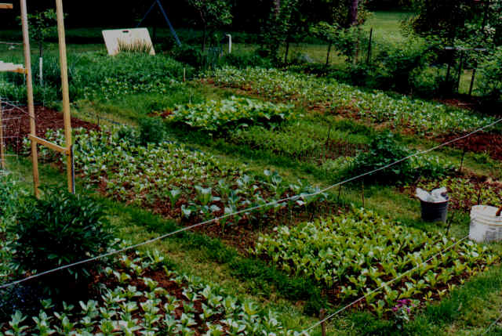
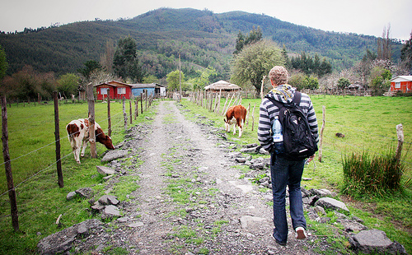
Subsistence Farming
Most common type of farming in Latin America
Small farm that grows barely enough food to survive.
May have some surplus food that is sold at a local market.

Slide 4
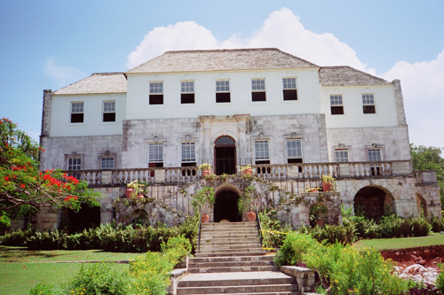
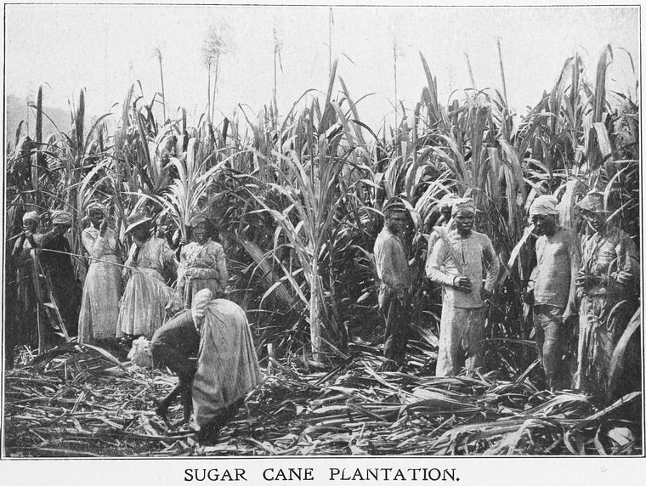
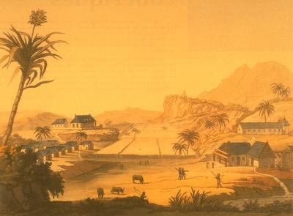
Plantation Farming
A plantation is a large commercially owned farm that employs many workers
Normally grows cash crops for export.

Slide 5
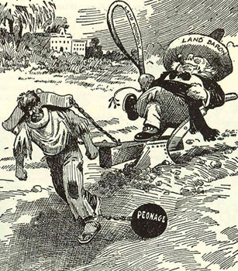
Haciendas
hacienda was a large estate (plantation).
most commonly ranchers
also grew food and had mines.
the owner of a hacienda was very rich
he employed poor laborers to do the work.
dominant economic force in Latin America until the late nineteenth century.
in many countries, they were broken up and the land was given to poor subsistence farmers

Slide 6
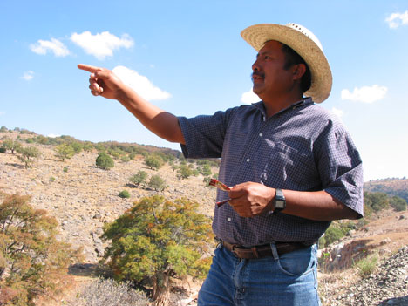
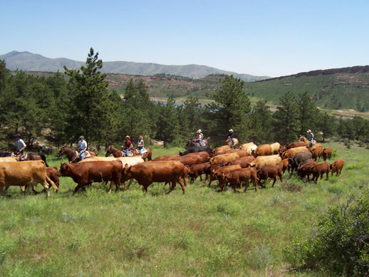
Cattle Ranches
the pampas in Argentina has many cattle ranches. Argentinian Cowboys are called gauchos. Brazil is also one of the leading exporters of beef in the world. Most of the cattle ranches in Brazil are located on the cerrados.

Slide 7
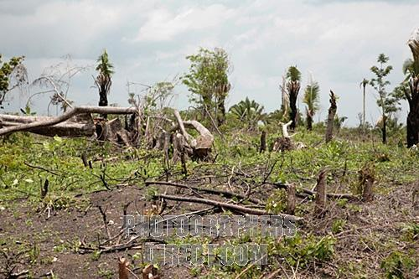
Slash and Burn
Common method of farming in tropical areas with large rainforests.
Farmers cut down trees and burn them in order to fertilize the soil.
After a few years this process must be repeated
Leads to deforestation.

Slide 8
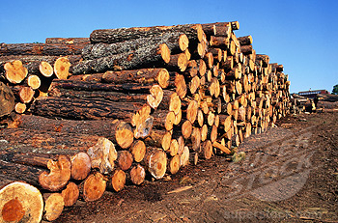
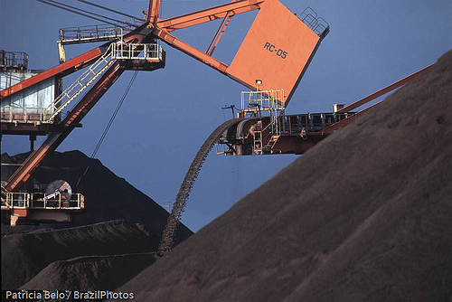
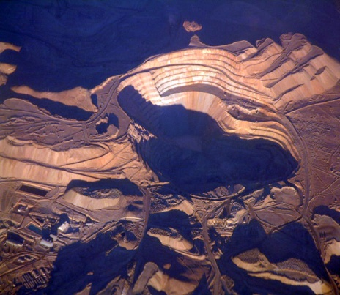
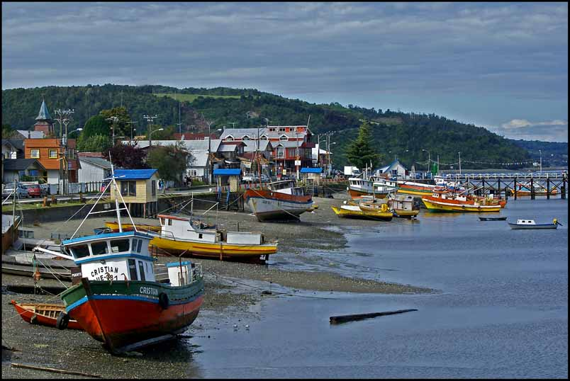
Diverse economies continued…
mining (for minerals and oil)
Copper (Chili), iron ore (Venezuela & Brazil), gold, bauxite, and silver
fishing
harvesting timber

Slide 9
OIL!
Ecuador, Venezuela, and Mexico - large oil reserves.
Venezuela - a leading exporter of oil to the United States.
Venezuela is a member of OPEC (Organization of Petroleum Exporting Countries) that controls the price and production of oil.

Slide 11
Caribbean and Central America
Very few mineral resources.
Rely on farming, timber, and tourism.

Slide 12
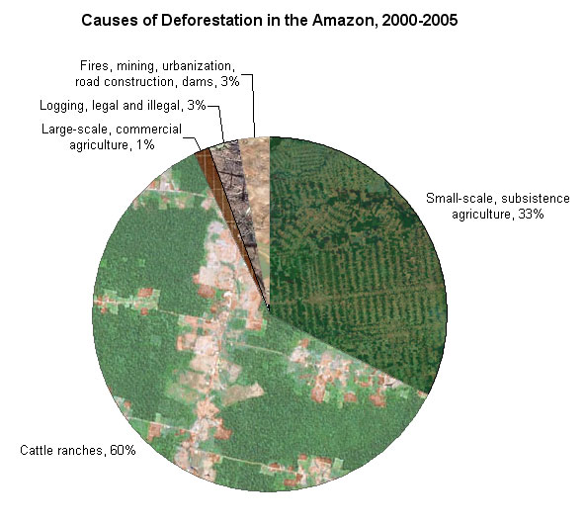
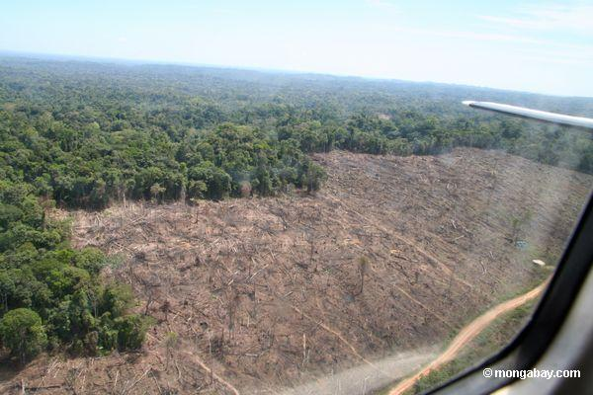
Deforestation
Most common environmental problem in Latin America.
Most of the islands in the Caribbean and the countries of Central America have very little forest left.
The Amazon Rainforest is being cut down for farmland, urban development, and the export of wood.

Slide 15
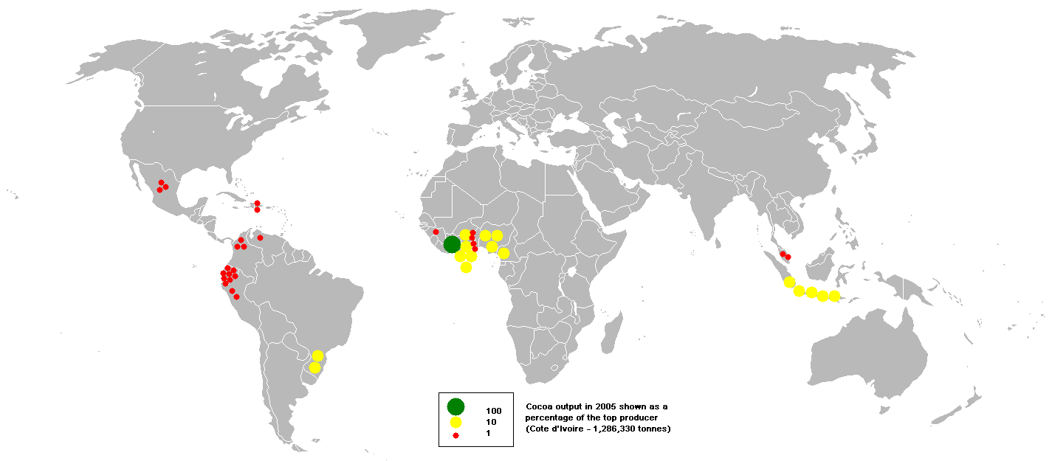
Natural Resources
Oil resources
Ecuador, Venezuela, and Mexico
Diverse mineral resources
(e.g., copper in Chile, iron ore in Venezuela and Brazil)

Slide 17
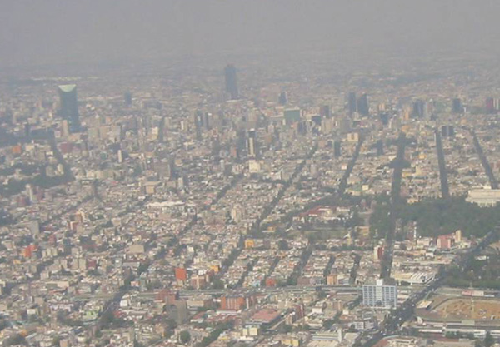
Heavy smog, pollution—Mexico City
Disparity of income distribution

Slide 18
Distribution of Wealth
Societies: lower, middle, and upper class.
The upper class is very rich
Lower class is not so well off.
Latin America tends to have a very small middle class and a huge lower class.
This is called disparity of income distribution.

Slide 20
North American Free Trade Agreement (NAFTA)
Mexico, Canada, and the U.S.
Abolishes most tariffs on imported goods between these countries increasing trade.
Downside: many industries from the U.S. moved to Mexico because of the cheap labor.
Set up factories across the border (maquiladoras) and export the products, such as textiles, back to the U.S.

