Slide 1
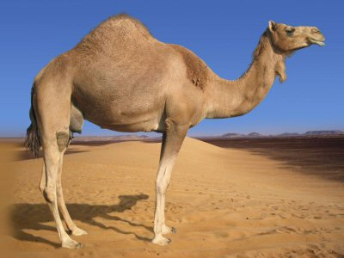
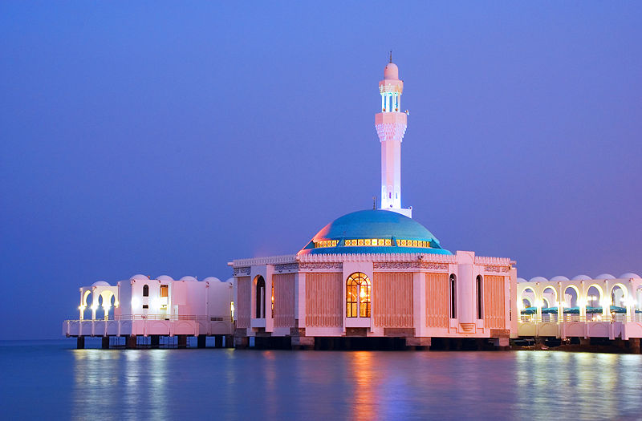
North Africa and Southwest Asia (Middle East) Cultural
Byvik
WG 4

Slide 2
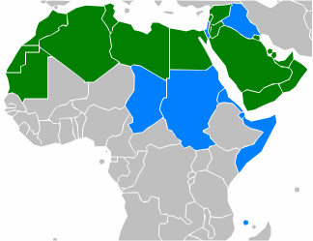
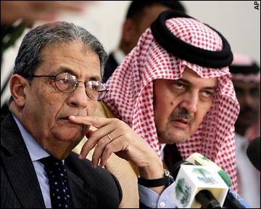
Arab:
An ethnic group primarily living in the Arab World (Africa & Asia)
Identify on genealogical, linguistic, or cultural grounds
Non-Arab countries: Turkey, Iran, Israel

Slide 3
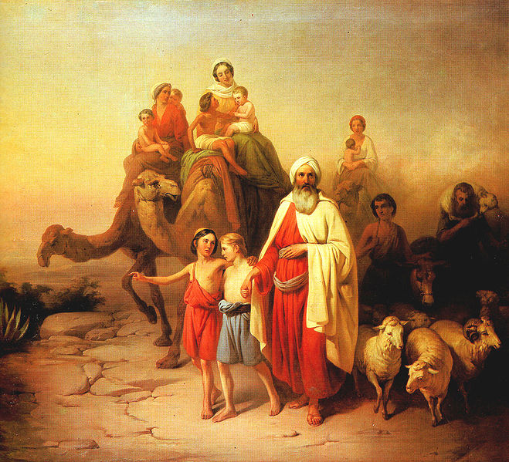
Birthplace of Abrahamic Religions:
Abraham was from Ur in Mesopotamia (modern Iraq)
Judaism and Christianity began mostly in Israel
Islam began in Saudi Arabia
Monotheistic religions
Judaism
Christianity
Islam
Conflict over Palestine/Israel
Art reflects the diversity of religions
stained glass, geometric tiles, calligraphy, mosaics, prayer rugs

Slide 4
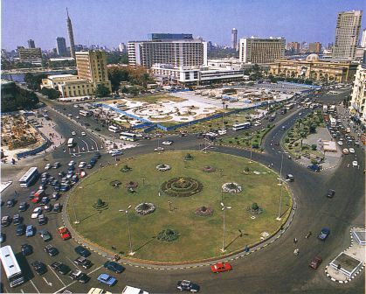
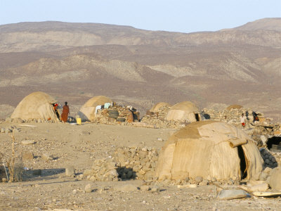
Population
Rapid urbanization
Oil industry had brought great wealth to a small percentage of the population
Cities have grown quickly as a result of the oil industry
Oil profits not used to stimulate other industries or improve infrastructure outside the cities
Modernization = urban areas
Traditional life = rural areas
Many people that live in rural areas still lead nomadic lifestyles
Widespread poverty, poor sanitation and medical care, and ongoing violence in rural areas

Slide 5
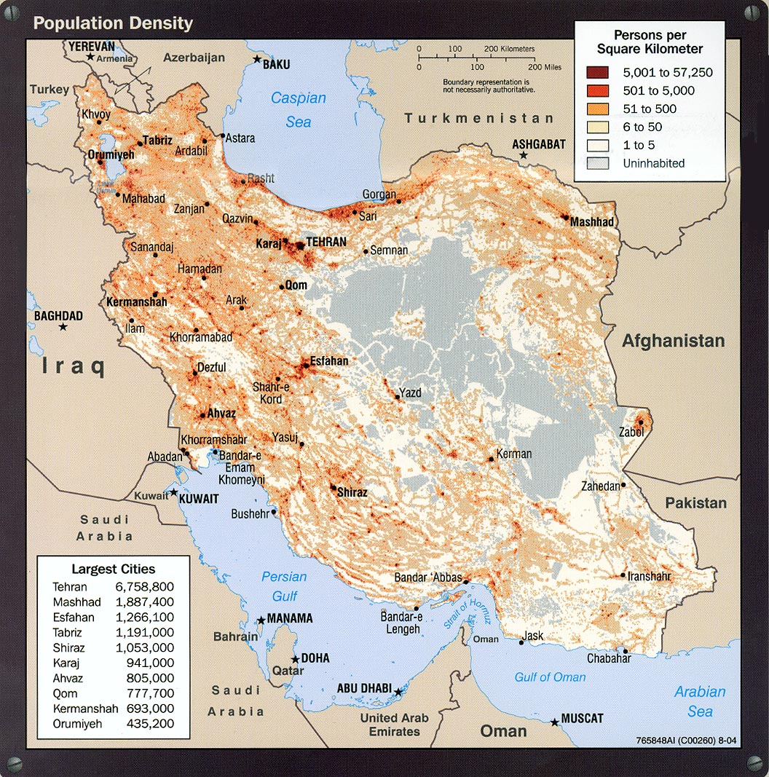
Population
Large percentage under age 15
Unevenly distributed
Generally people live close to natural resources
In the M.E. people must live near a water source
populations concentrated on coastlines and near rivers (Nile, Jordan, etc.)
smaller populations around wadis
Recently, populations centered near oil reserves

Slide 6
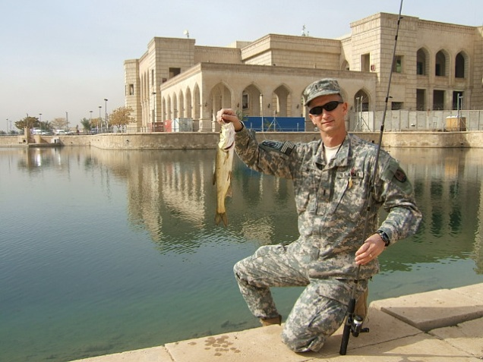
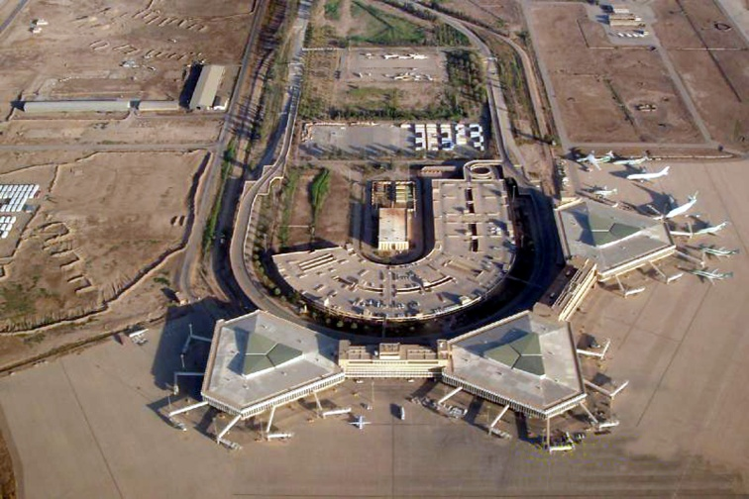
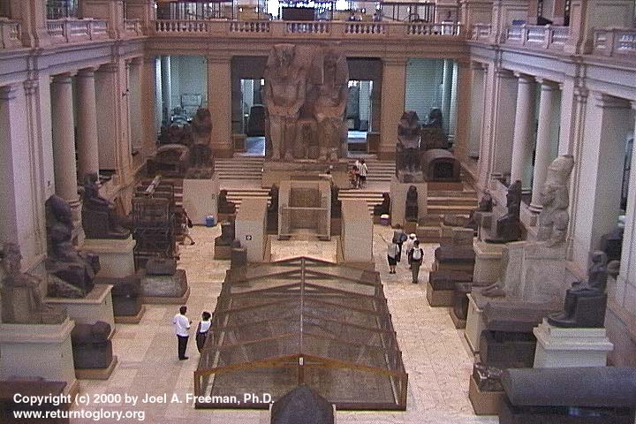
Cities as Centers of Culture and Trade
Baghdad
Capital of Iraq built on the banks of the Tigris River (river is navigable between Baghdad and Persian Gulf)
Center of education, religion, cultural activity before the recent violence
Conquered many times throughout history; near ancient Babylon
Cairo
Capital city of Egypt on the Nile River Delta; Near Giza; many ancient Pyramids can be seen from Cairo
Cairo Museum displays many ancient Egyptian artifacts; major area of trade, highly respected universities, beautiful mosques
Tehran
Capital city of Iran; includes many famous mosques; Center of education and culture in Iran

Slide 7
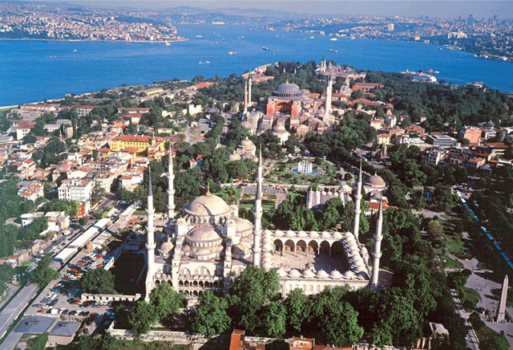
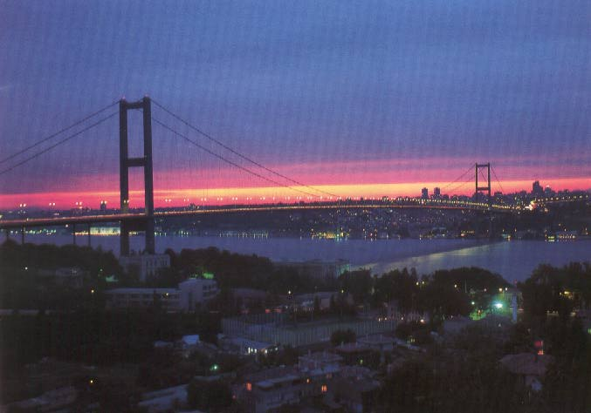
Cities as Centers of Culture and Trade Continued..
Istanbul
Largest city in Turkey; straddles the Bosporus Strait
Strategic location made this a very important city to control shipping between the Black Sea and the Mediterranean
Formerly called Byzantium and Constantinople; Includes many famous mosques, including the Hagia Sophia

Slide 8
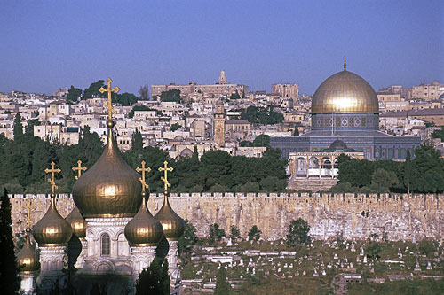
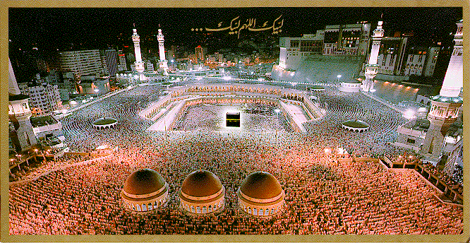
Cities as Centers of Culture and Trade Continued..
Jerusalem
Ancient walled city built on a hilltop; current capital of Israel
Holy city to the three Abrahamic religions; city is divided into sections of religious influence
City includes the Western Wall (Judaism), Church of the Holy Sepulcher (Christianity), and the Dome of the Rock (Islam)
Bethlehem, the town of Jesus’s birth, is just outside of Jerusalem
Mecca
Holiest city in Islam; located in Saudi Arabia
Site of Muhammad’s birth
Kaaba is located here
Only Muslims are allowed to enter this city

Slide 9
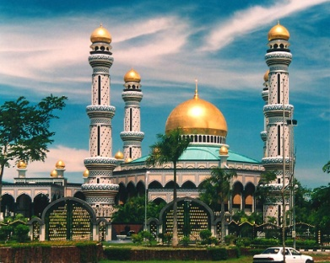
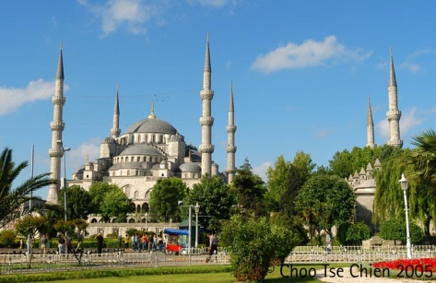
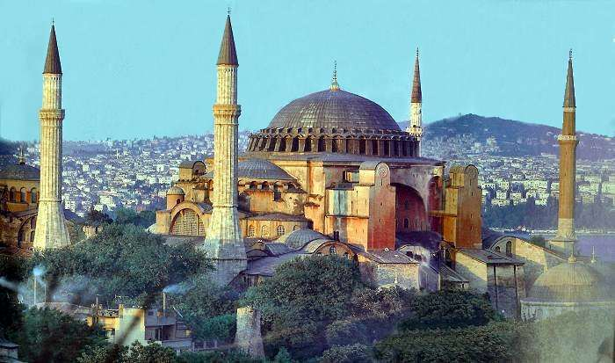
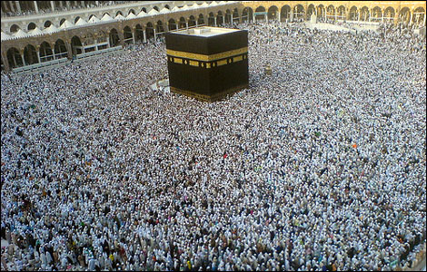
Cultural Landscape
Mosques, Minarets
Many beautiful mosques in Turkey, Iran, Egypt; often surrounded by minarets; the tallest minaret is in Casablanca, Morocco
Hagia Sophia (The Church of Holy Wisdom)
In Istanbul (near Bosporus Strait)
Originally built as an Orthodox Christian church during the reign of the Eastern Roman Empire
Converted to a mosque after the Ottoman Turks conquered Constantinople and renamed it Istanbul; Minarets were added after the Muslim conquest
Currently serves as a museum displaying Christian Icons and Muslim artwork
Kaaba
Islamic holy site in Mecca, Saudi Arabia, the city of Muhammad’s birth
Center of Islamic prayer; Muslims face the Kaaba to pray to Allah (God)

Slide 10
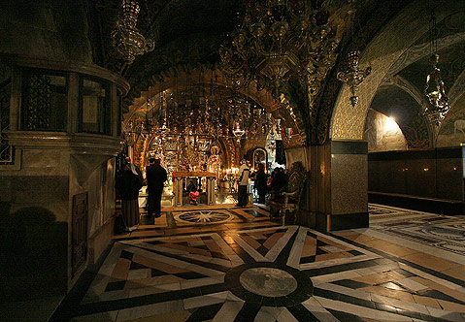
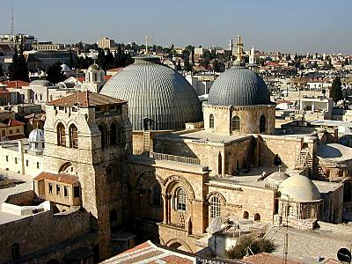
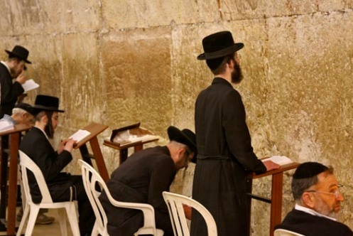
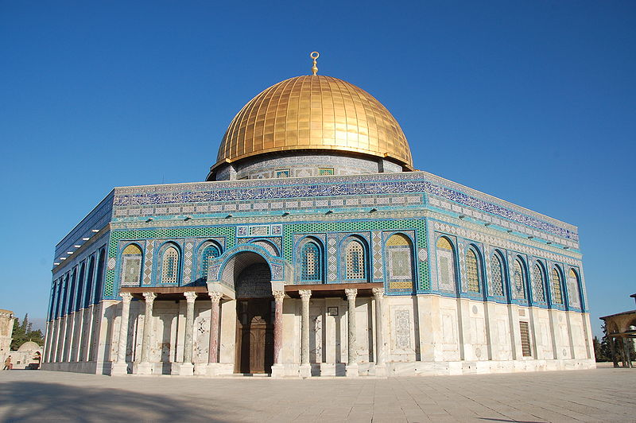
Cultural Landscape continued..
Church of the Holy Sepulcher
Christian holy site in Jerusalem, Israel
Many believe this is the site of Jesus’s crucifixion and burial
Western Wall
Only remaining part of an ancient Jewish temple in Jerusalem, Israel
Major site of Jewish prayer
Dome of the Rock
Islamic holy site in Jerusalem, Israel
Built on the site where Muhammad ascended to heaven

Slide 11
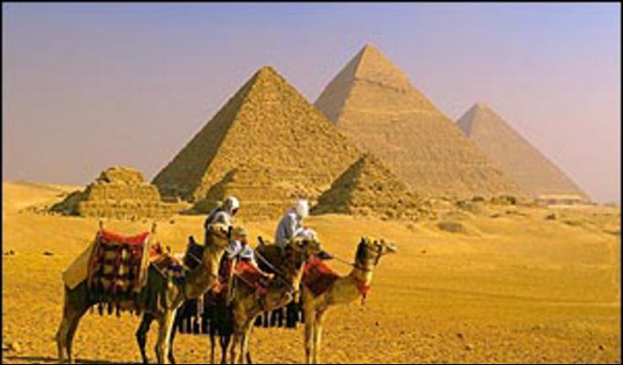
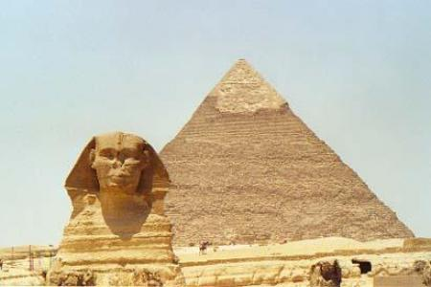
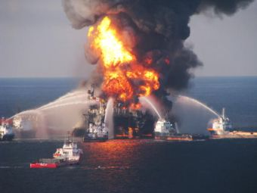
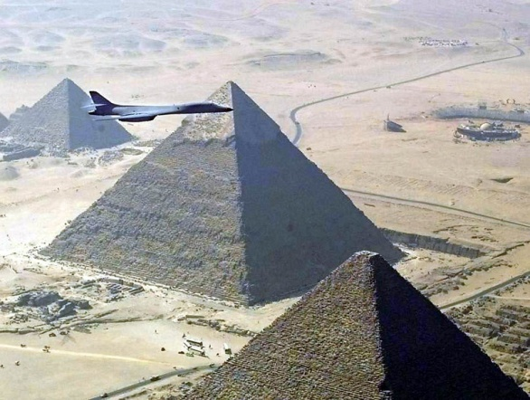
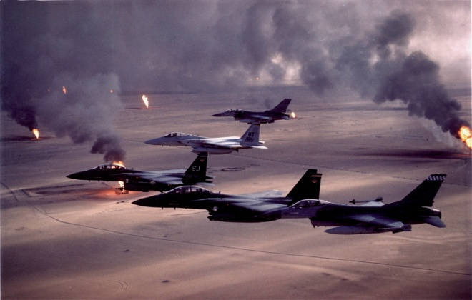
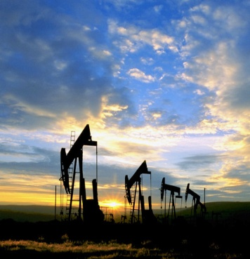
Cultural Landscape continued..
Pyramids
Mostly found in Egypt and the Sudan near the Nile River built by aliens
Ancient burial sites for prominent Egyptian pharaohs
The Great Pyramid is found in Giza, near Cairo, Egypt
Oil Rigs
Used to drill for oil that is found underground
land rigs and offshore rigs are used in Middle East
Frequently found in the Persian/Arabian Gulf and off the coast of Iran in the Caspian Sea

Slide 12
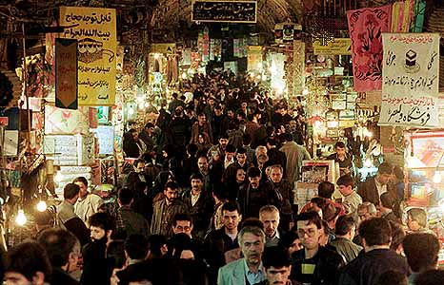
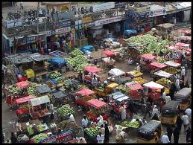
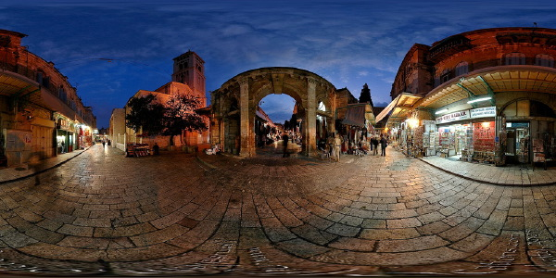
Cultural Landscape continued..
Bazaars, Suqs:
Suq: commercial center of an Arab city
Many merchants compete for business in the same area; prices are often determined by bargaining with the vendor
Often includes a bazaar, a market that is often covered
“Bazaar” comes from an old Persian word meaning “the place of prices”
Famous bazaars are found in Istanbul, many cities in Iran, Morocco, etc.

Slide 13
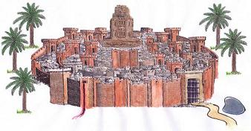
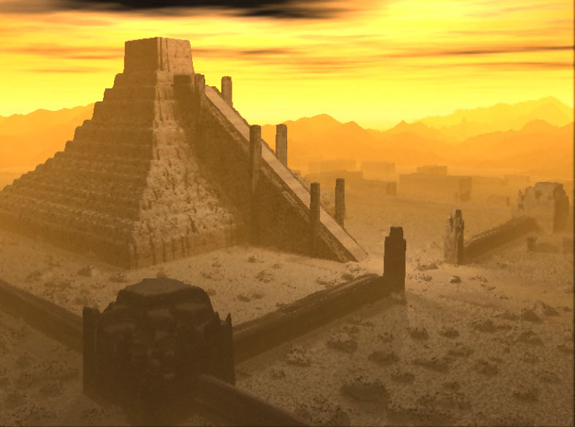
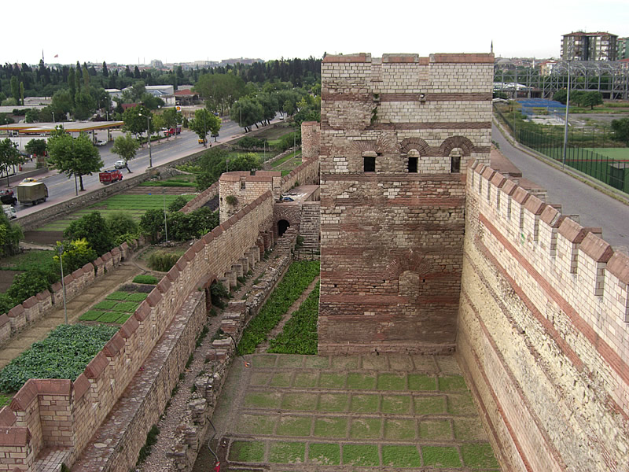
Cultural Landscape continued..
Walled Cities
Many ancient Mid. East. cities were built with fortified walls to protect them
Famous examples: Jerusalem, Jericho, Istanbul (formerly Constantinople)

