Slide 1
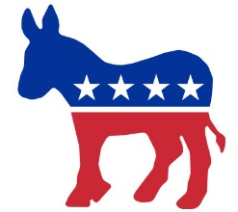
The Political Spectrum
In favor of BIG GOV
In favor of SMALL GOV
Center
Right
Left
Liberal
Democrats
Moderate
Independent
Centrists
Conservative
Republicans
Functions of Political Parties
Educate the electorate about issues
Monitor the actions of office holders
Help candidates win elections
Recruit and nominate candidates

Slide 2
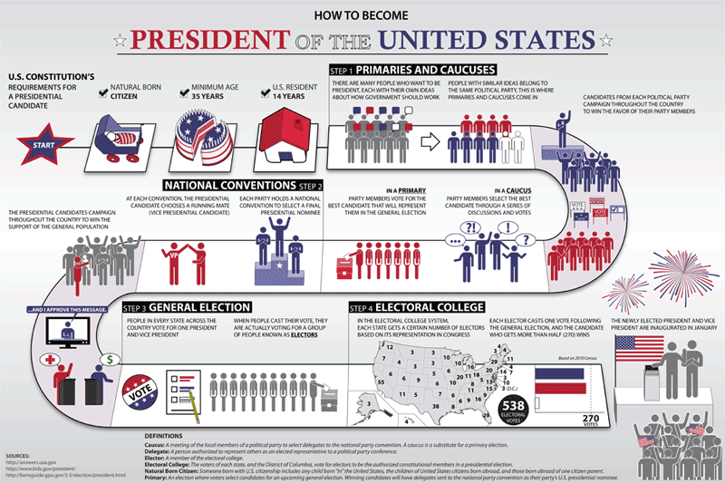

Slide 3
CE 5b
PAAARRRRTAAAAAAAAYYY!!
Similarities
A 2 party system characterizes the American political process
Organized to win elections
Influence public policy
Third parties
Reflect both Liberal and Conservative Views
Intro new ideas or press for a particular issue
Third parties rarely win elections, but they play an important role in public politics
Define themselves in a way that wins the majority support by appealing to the Political center.
Often revolve around a political personality like Theodore Roosevelt
Differences between Parties
Found in the parties platform and reflected in campaigning

Slide 4
CE 5c
Analyzing campaigns
Strategies for evaluating campaign speeches, literature and advertisements for accuracy
Voters evaluate information presented in political campaigns to make reasoned choices among candidates
Separate fact from opinion
Detecting bias
Evaluating sources
Identifying propaganda
Mass media roles in elections
Identifying candidates
Emphasizing selected issues
The media plays an important role in the political process
Writing editorials, creating political cartoons, publishing Op-Eds
Broadcasting different points of view

Slide 5
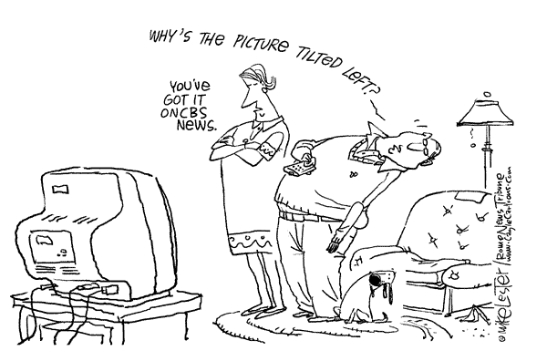
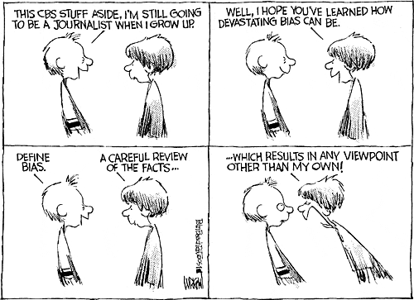
Bias is an inclination to present or hold a partial perspective at the expense of (possibly equally valid) alternatives. Anything biased generally is one-sided, and therefore lacks a neutral point of view.

Slide 6
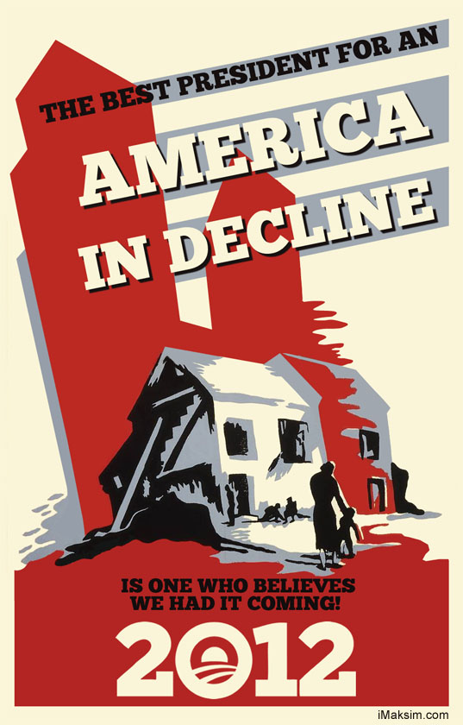
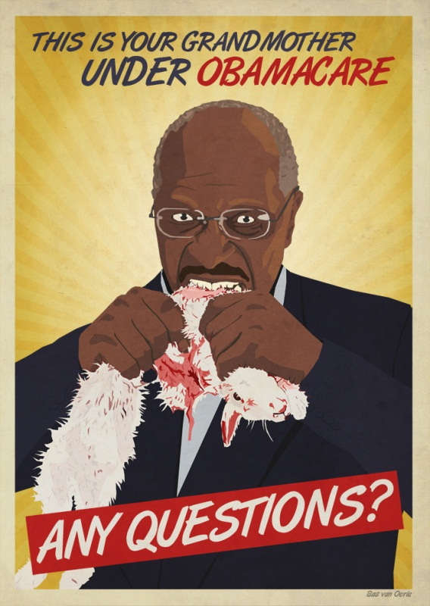
Propaganda is a form of communication that is aimed at influencing the attitude of a community toward some cause or position by presenting only one side of an argument.

Slide 7
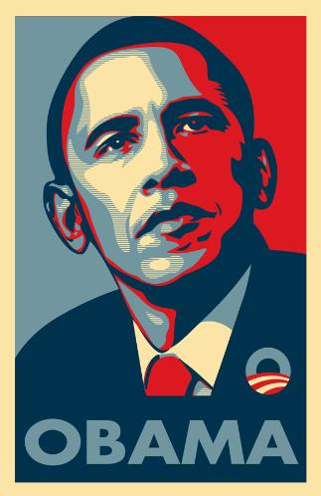
HMMMMMMM????? Whats up with THIS?

Slide 8
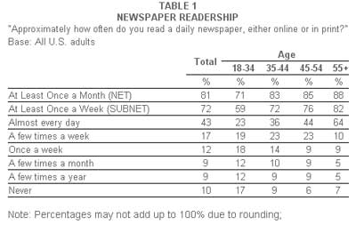
When looking at the chart below; what assumptions might you make about traditional media?

Slide 9
CE 5d
Examining the role of campaign costs
Rising campaign costs
Campaign ﬁnance reform
require candidates to conduct
extensive fund-raising
activities.
Rising campaign costs have led
to efforts to reform campaign
ﬁnance laws.
limit opportunities to run for
public ofﬁce.
Limits exist on the amount
individuals may contribute to
political candidates and
campaigns.
give and advantage of wealthy
individuals who run for ofﬁce
encourage the development of
political action committees
(PAC"s).

Slide 10
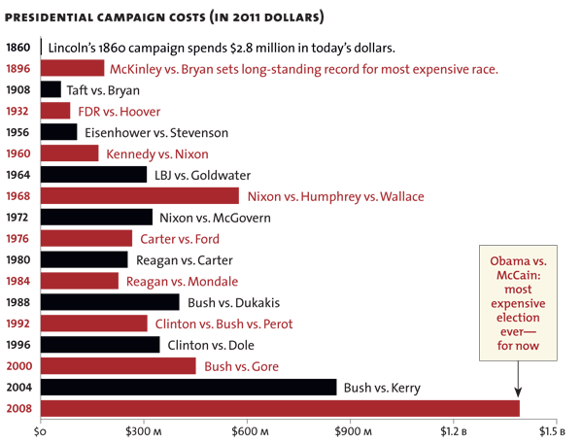

Slide 11
Super dooooper mackin cewl assigment!!!
Im gonna put you in groups and you are gonna find some groovey stuff out!
Do an internet search for the Party Platforms for the Dems and Reps!
In your note list 5 that you think are the most important ideas to YOU!!
As you read through the Platforms for each party, be prepared to discuss the differences and similarities.

Slide 12
http://www.democrats.org
www.gop.com

