Slide 1
Civics
Fast and dirty review

Slide 2
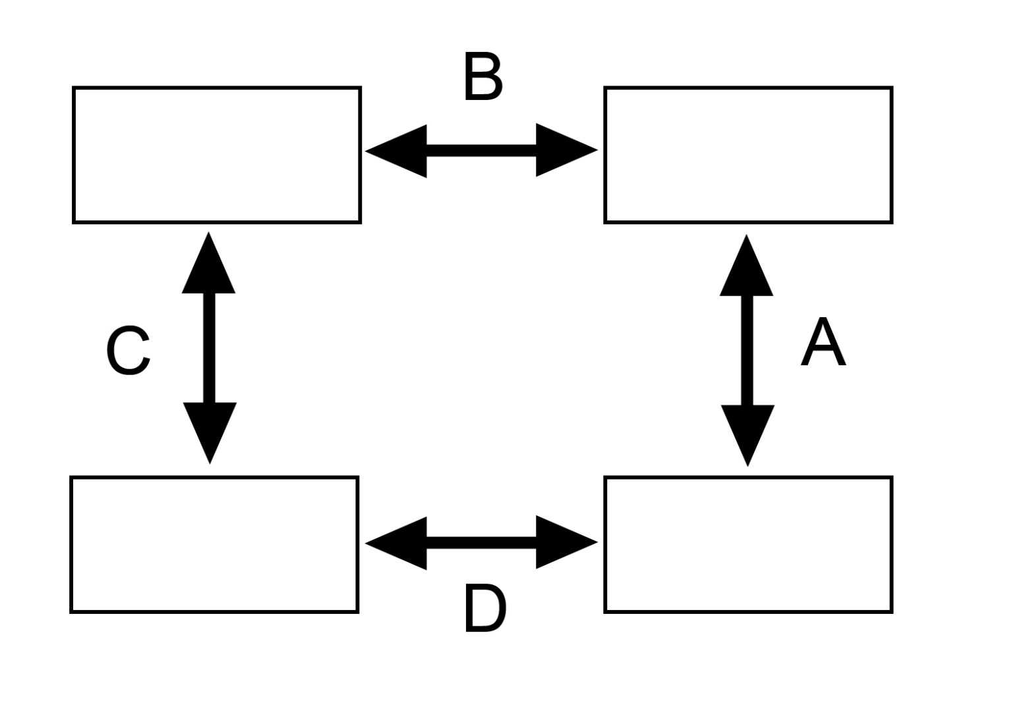
Which letter shows the right connection ?
Judicial Review
Supreme Court
The U.S. Congress
Veto
A. B. C. D.

Slide 3

Which of these headlines is most closely connected to lobbying?
A. NRA spends millions on PR campaign
NRA spends millions on PR campaign
FCC bans TV ads
B. President vetoes bill
President vetoes bill
Senate rejects judge
C. FCC Bans TV ads
D. Senate rejects judge

Slide 4
What is ?
A. U.S. Supreme Court
Va. Supreme Court
B. U.S. Circuit Court
C. Va. Circuit Court of Appeals
?
D. Attorney General
General District Courts
Circuit Courts

Slide 5
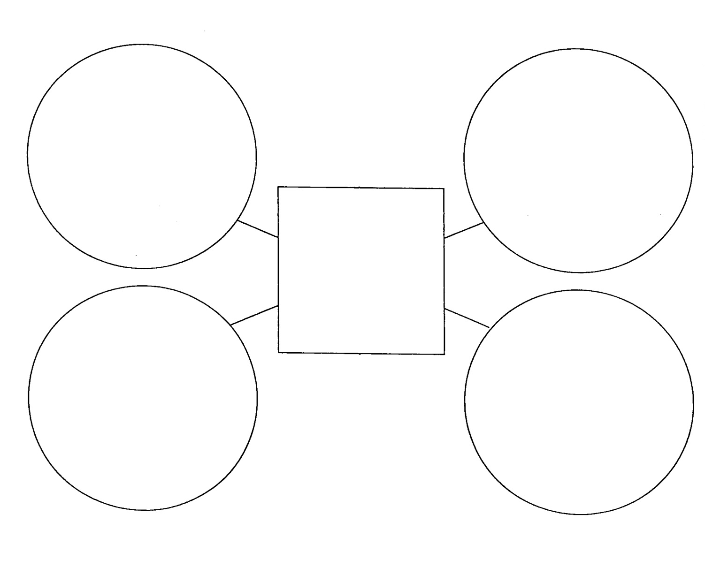
Which Amendment?
Don’t have to testify against yourself
No double jeopardy
?
Government can’t unfairly take land
Must have due process
A. 1st B. 5th C. 8th D. 10th

Slide 6
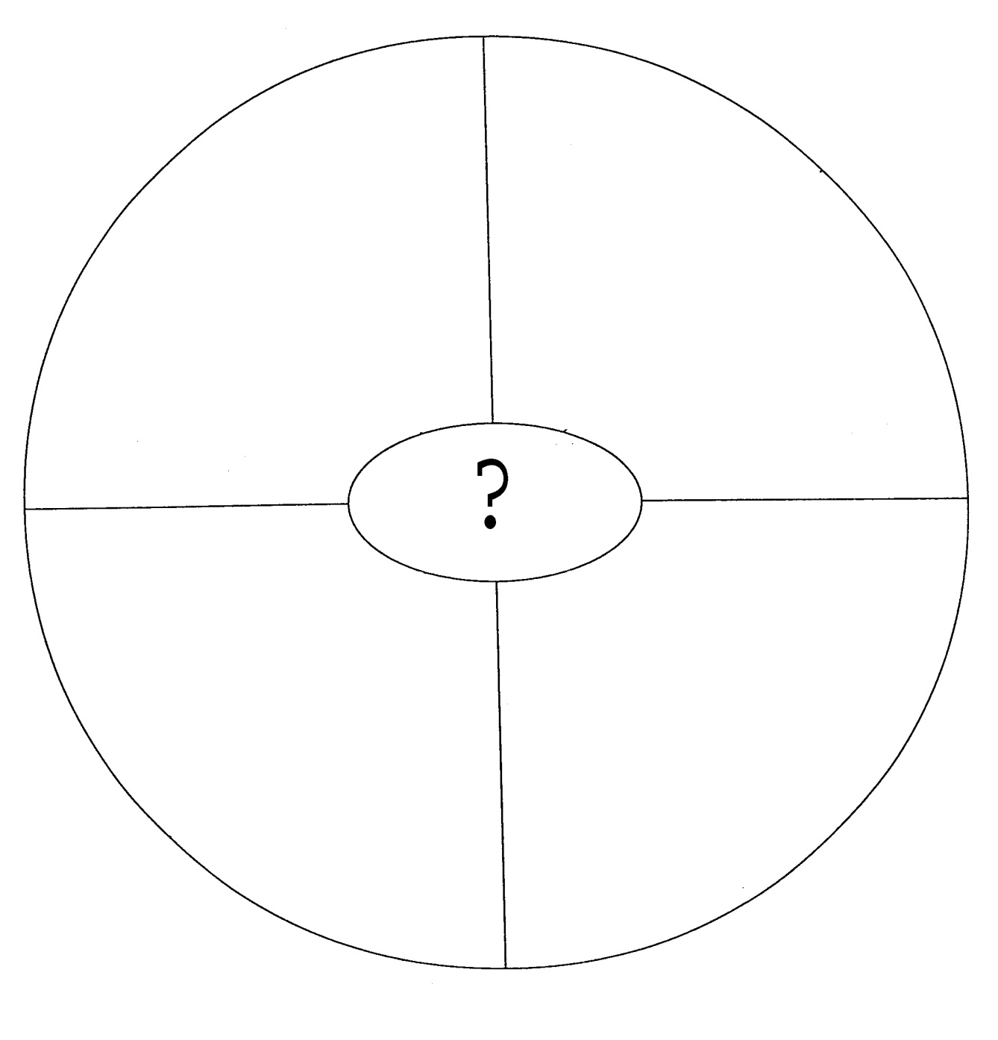
Establish Justice
Provide defense
Form a Union
Ensure domestic peace
A. Declaration of Independence B. Articles of Confederation C. Preamble to Constitution D. Va. Declaration of Rights

Slide 7
Which Document?
Va. Declaration of Rights
Articles of Confederation
Declaration of Independence
Charters of Va. Company of London
Rights of Englishmen guaranteed to colonists

Slide 8
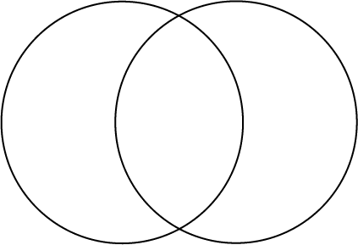
What Does “X” Represent?
X
Y
* Power mostly resides with states
* Power mostly resides with national government
*A Plan for a National Government
* No power to tax or enforce laws
* Has power to tax, enforce laws & regulate interstate trade
* No national courts
* Has federal courts
Articles of Confederation B. U.S. Constitution
Virginia Declaration of Rights D. Charters of Va. Company of London

Slide 9
Which economic system ?
A. Command
Apple vs. Microsoft Helps Consumers
Car Dealers Offer Bargains!
B. Mixed
Pepsi’s Profits Way Up!
Home Sales Soar
C. Free Market
D. European

Slide 10
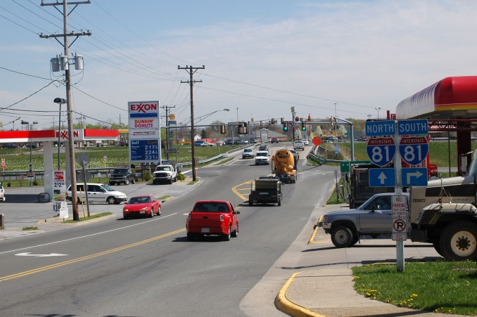
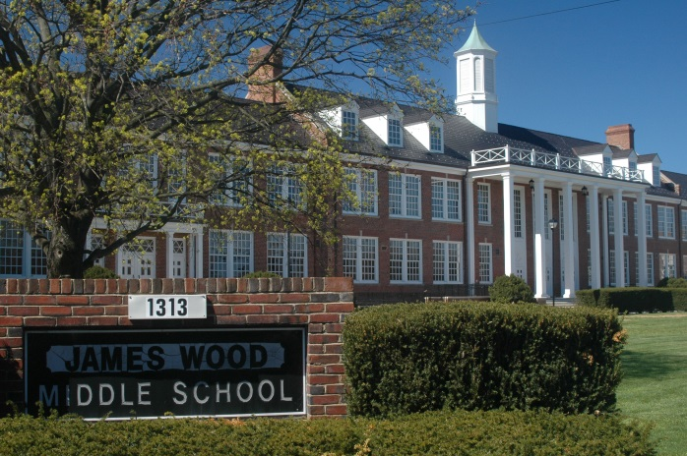
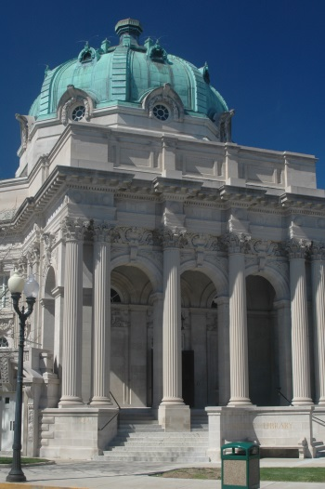
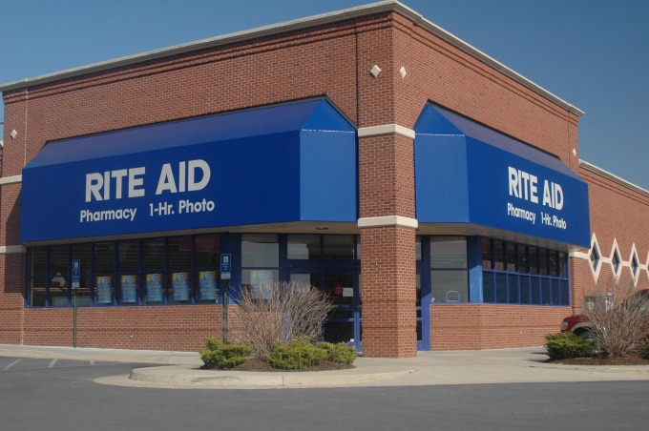
Which is not a public service?
A
B
C
D
A. Highways B. Schools C. Libraries D. Pharmacies

Slide 11
What concept is most closely associated with this quote?
“Let’s make products that people want.”
Consumer protection
Consumer sovereignty
Opportunity cost
Central planning

Slide 12
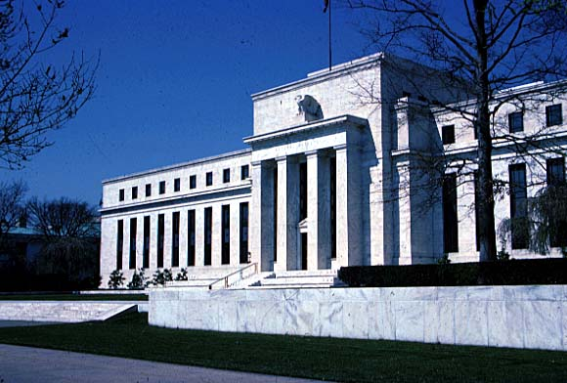
What is the Building?
Lower Prime Rate
Decrease Reserve requirement
Purchase Government securities
A. U.S. Capitol Building B. U.S. Supreme Court Building C. The F.C.C. Building D. The Federal Reserve Building

Slide 13
What is the effect of these actions?
Lower Prime Rate
Decrease Reserve requirement
Purchase Government securities
A. Slow the economy B. Stimulate the economy C. Keep economic activity neutral D. It usually has no effect

Slide 14
What is ?
?
Would not be available if individuals had top provide them
Provides benefits to many simultaneously
Includes things like the postal service
A. Public goods and services B. Entrepreneurial services C. Private enterprise goods and services D. Capital gains services

Slide 15
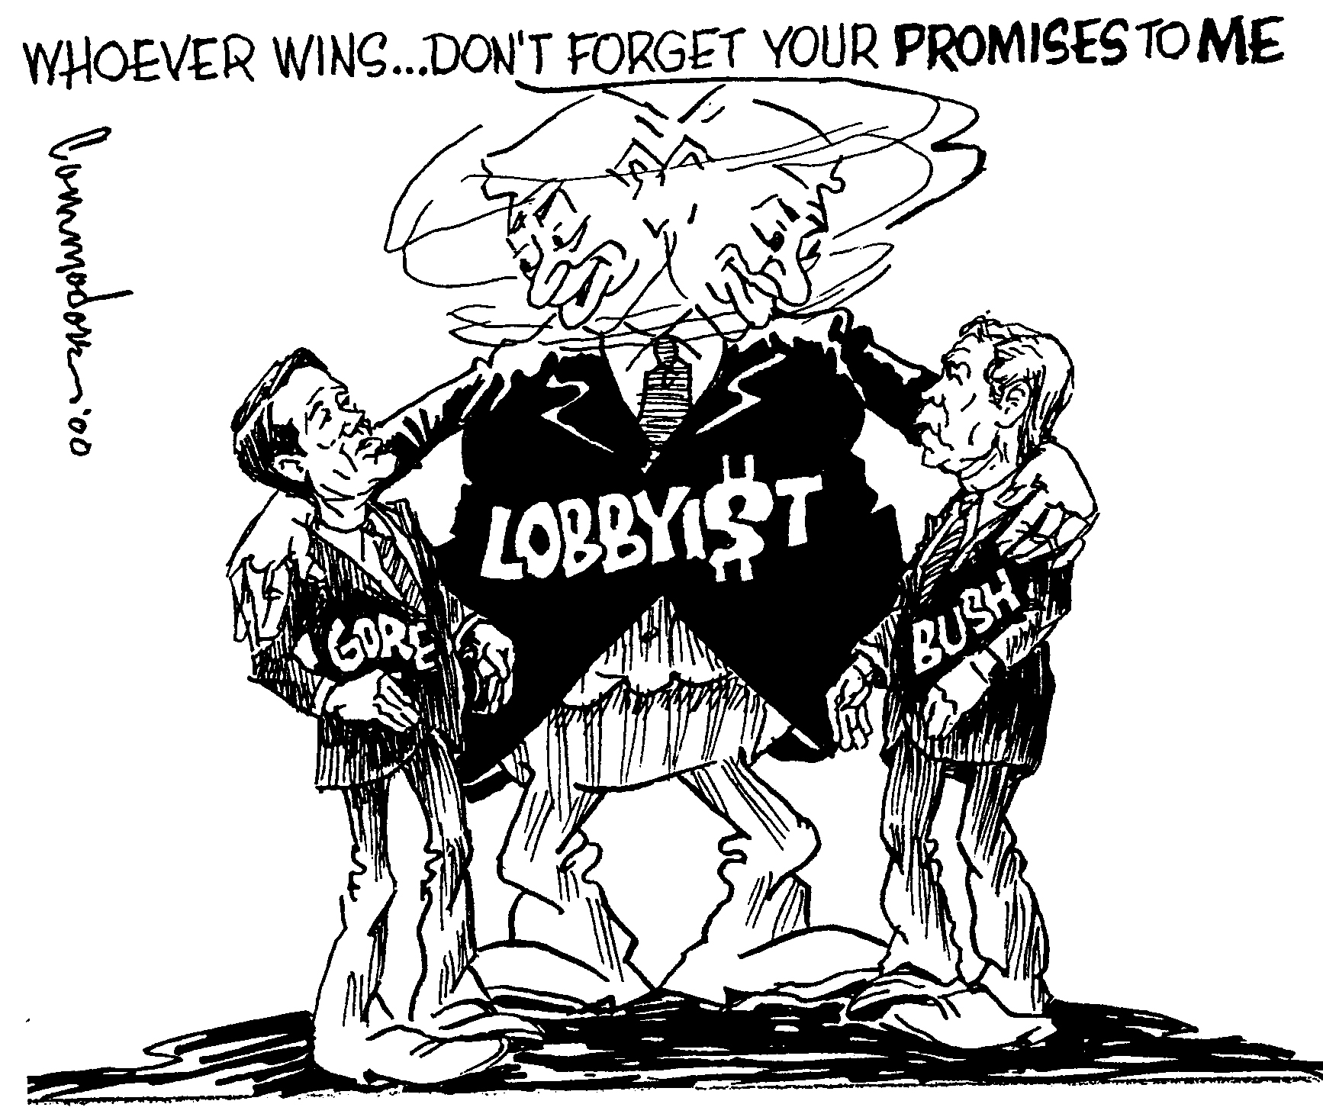
What does this cartoon suggest?
Lobbyists should be banned
Lobbyists can’t make up their minds
Lobbyists try to have influence in both parties
Lobbyists always lie

Slide 16
What completes this table?
State | Federal
Sets standards for Drivers’ Licenses | Conducts Foreign Policy
Establishes public schools | Prints currency and mints coins
Licenses doctors | ?
Imposes fines for illegal burning
Maintains the Armed Services
Sets minimum age for work permits
Sets standards for zoning laws

Slide 17
What is the source?
Establish Justice
Form a Union
?
Ensure Domestic peace
Provide defense
A. Preamble to Constitution B. Articles of Confederation C. Declaration of Independence D. Va. Declaration of Rights

Slide 18
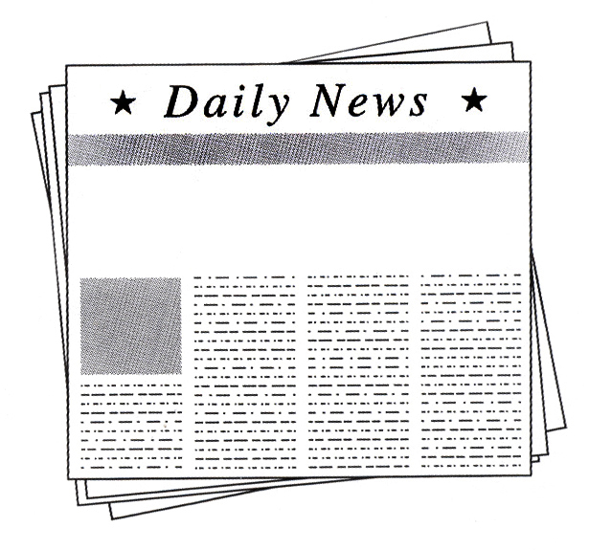
Which Government Agency would most likely head the investigation?
EPA
B. FTC
C. FCC
D. NAFTA
Shock Jock Scandal
Radio Obscenity Case Reviewed

Slide 19
Which Document?
Va. Declaration of Rights
B. Articles of Confederation
C. Declaration of Independence
D. Charters of Va. Company of London
“We hold these truths to be self-evident, that all men are created equal, that they are endowed by their Creator with certain unalienable Rights, that among these are Life, Liberty and the pursuit of Happiness. That to secure these rights, Governments are instituted among Men, deriving their just powers from the consent of the governed.”

Slide 20

What is the 3rd Freedom?
A. To Bear Arms
B. To Travel
C. To Peacefully assembly
D. To hire a lawyer
Freedom of Speech
?
Freedom of Religion
1st Amendment

Slide 21
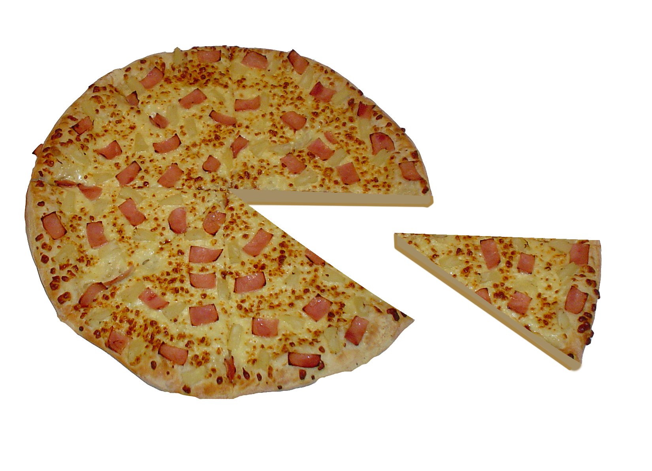
First Amendment Pizza
Press
Religion
Speech
?
Assembly
A. Right to Due Process B. Right of Petition C. No illegal searches D. No Self incrimination

Slide 22
What is the source?
Amendment 1
B. Amendment 2
C. Declaration of Independence
D. Amendment 14
All persons born or naturalized in the United States, and subject to the jurisdiction thereof, are citizens of the United States and of the state wherein they reside.

Slide 23
Which Government Agency would most likely head the investigation?
EPA
B. FTC
C. FCC
D. NAFTA
Exxon Mobil Oil Spill
Did Oil Giant Lie?

Slide 24
Which letter shows the right connection ?
The U.S. Congress
Declares laws unconsititional
Overrides Veto
President
A. B. C. D.

Slide 25

Best strategies for evaluating campaign speeches, literature, & ads.
Detecting Bias
Identifying propaganda
Strategies for evaluating campaign speeches, literature, & ads.
Evaluating sources
?
A. Checking the copyright B. Separating fact from opinion C. Making sure it’s produced in the U.S. D. “Googling” the printer

Slide 26
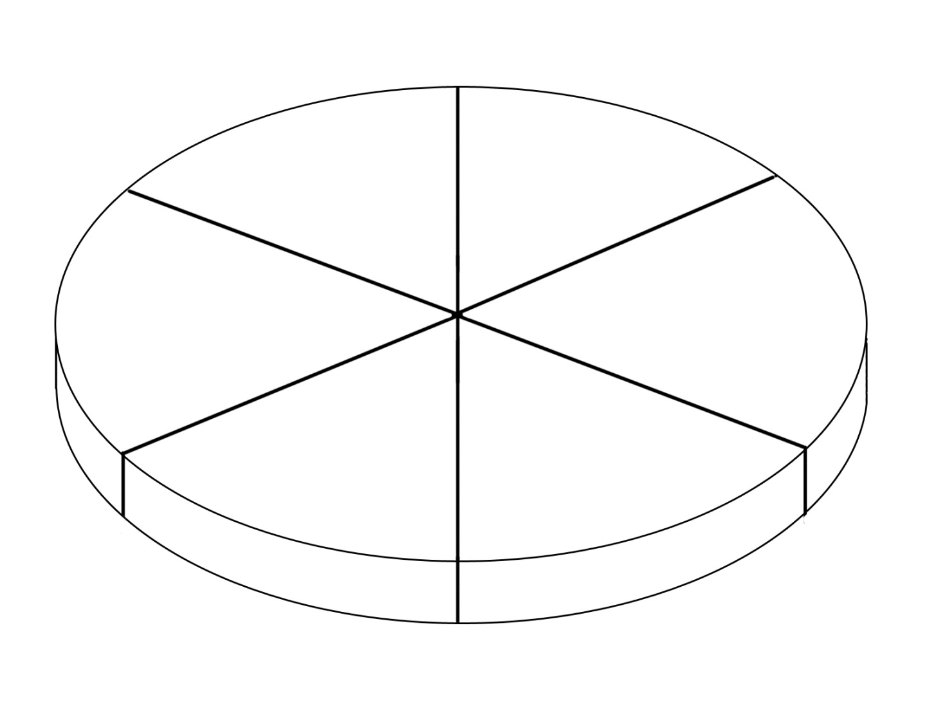
“Fundamental Political Principles” Pie
Rule of Law
?
Consent of Governed
Limited Government
Democracy
A. Judicial review B. Congressional Committee System C. Representative government D. Executive Action

Slide 27
What caused these headlines ?
A. Inflation
Few candidates register for race
Pro-Abortion Groups feel the power
B. Rising campaign costs
Jones out of $ drops out of race
C. New lobbying rules
PACs Give record amounts
D. Complicated election laws

Slide 28

What does this probably mean?
Lower interest rates on loans
B. More money in the economy
C. Reduced consumer spending
D. Rapid inflation
The Fed Raises the Prime
Fed Chairman

Slide 29
What Type Economy?
Mixed economy
Free Market
Command
Super Capitalist
Government decides production
Little private property
Lack of consumer choice
?

Slide 30

Which Branch Has These “Checks”?
Approves Federal judges
Overrides Vetoes
?
Impeaches Federal Judges
Impeaches Presidents
A. Legislative Branch B. Executive Branch C. Judicial Branch D. Covert Intelligence Branch

Slide 31
Who or what is being portrayed?
I have an idea for a business
?
I’ll raise money to start it
I’ll take the risk to make a profit
Chairman of the Federal Reserve B. A Federal Regulator
C. An entrepreneur D. An F.T.C. Official

