Slide 1
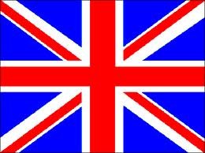
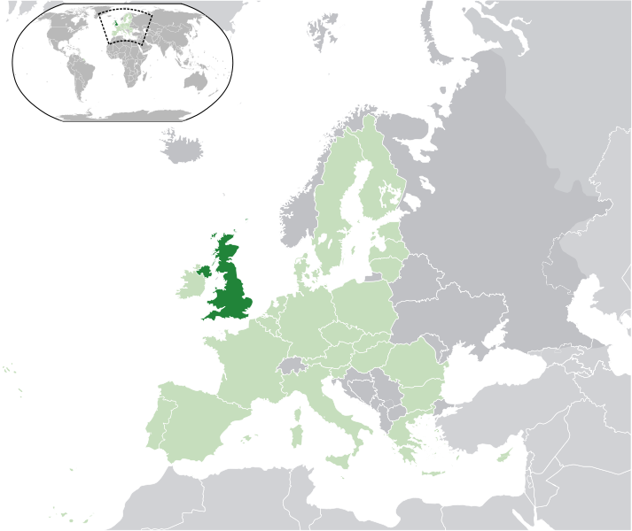
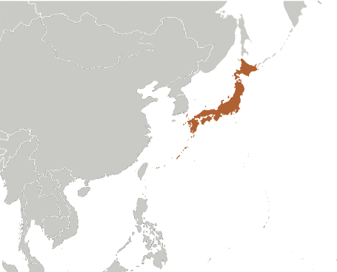
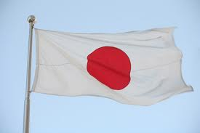
Japan vs. United Kingdom
Mr. Bringenberg’s Final Projects
WG. 4

Slide 2
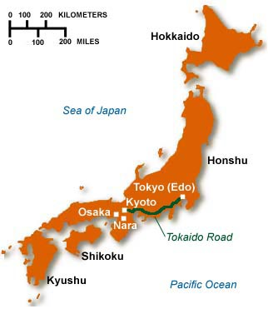
Physical Geography: Japan
Over 6, 800 Islands
Located on the Ring of Fire
108 active volcanoes
73% is mountainous and forested =/= arable
Temperate climate
Avg winter temp is 41
Avg summer temp is 77
Rainy seasons
145,925 sq mi
United States = 3,794,101 sq mi
Virginia = 42,774.2 sq mi

Slide 3
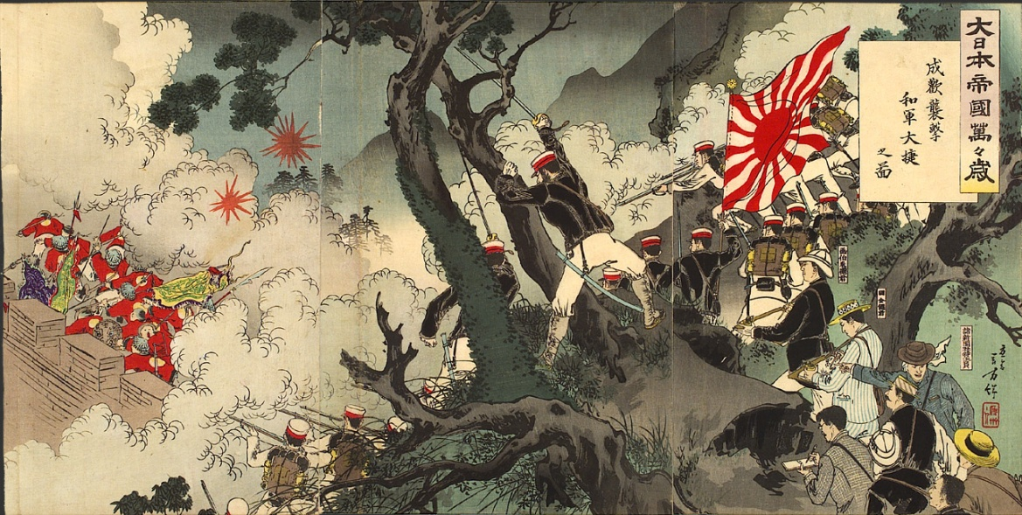
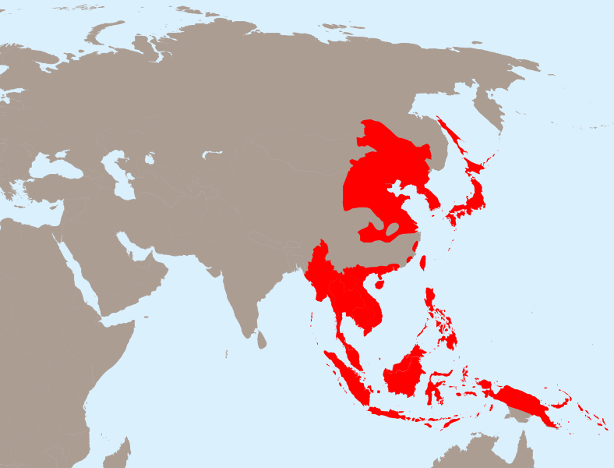
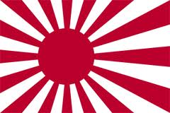
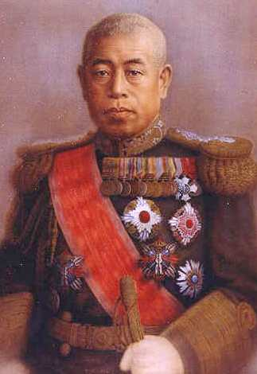
The Japanese Empire

Slide 4
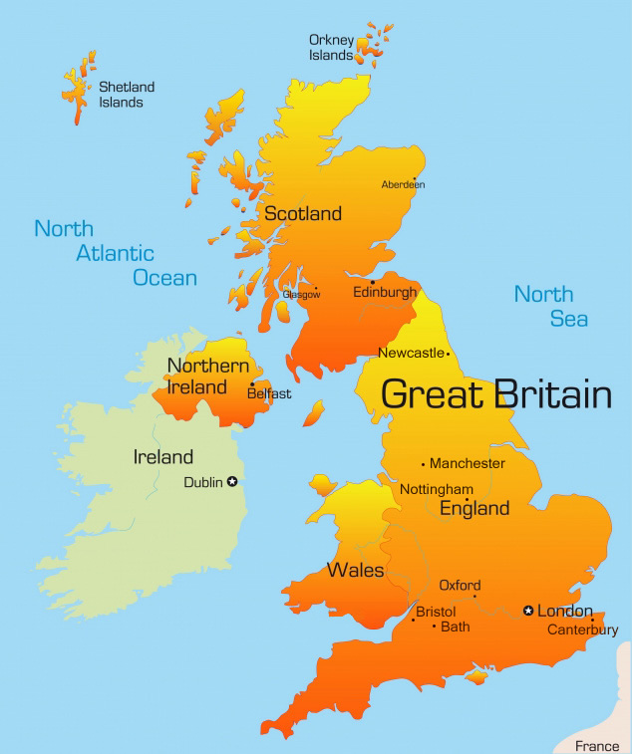
Physical Geography: United Kingdom
Consists of Great Britain, N.E. one-sixth of Ireland & smaller surrounding islands.
Between the N. Atlantic Ocean and the North Sea
Coast 22 miles off the coast of northern France
English Channel
10% of the UK is forested
46% used for pastures
25% used for agriculture
Temperate Climate
Plenty of Rain
Temperature varies with the seasons seldom dropping below 14.0° or rising above 95 °F
94,060 sq mi

Slide 5
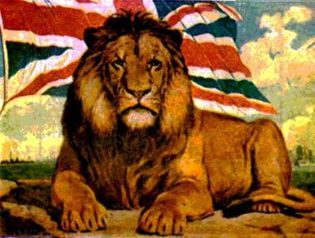
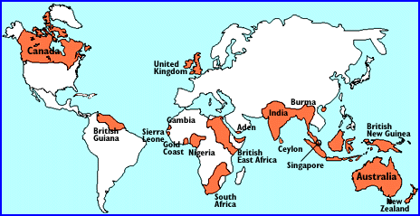
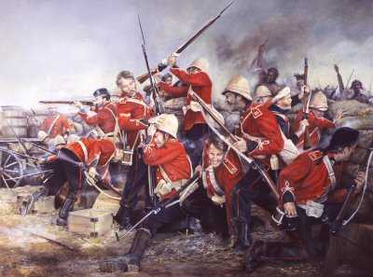
The British Empire

Slide 6
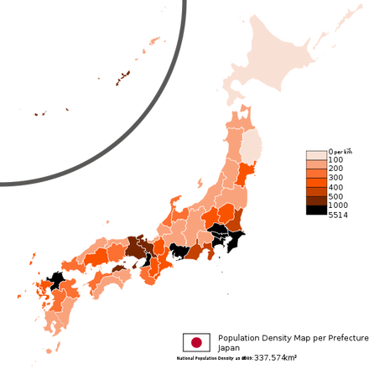
Population: Japan
127 million people
312 million in U.S.
Population Density: 873.1/sq mi
202.6/sq mi in VA
Tokyo is the largest metropolitan area in the world (+30 million)
Ultra modern cities
Large amount of people near coasts

Slide 7
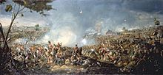
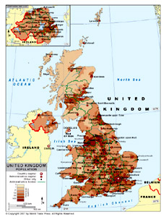
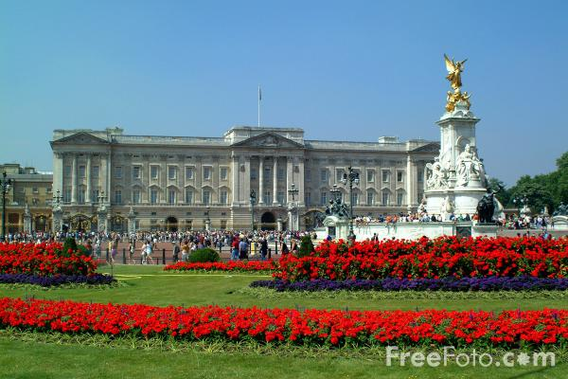
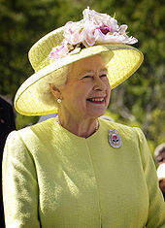
Population: United Kingdom
62 million
Population density: 659.9/ sq mile
Territories have an additional 260k people

Slide 8
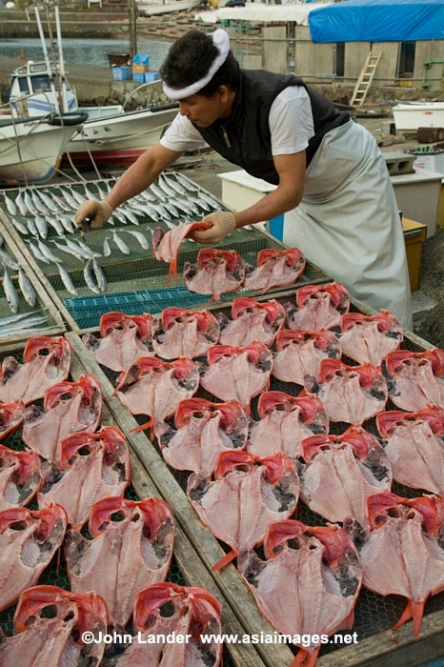
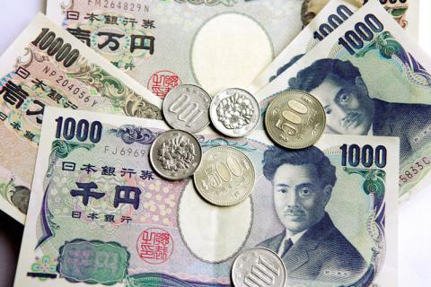
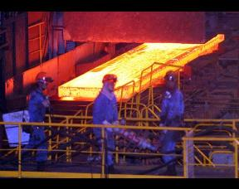
Economy: Japan
Isolated until 1868- focused on infrastructure
After 1868 embraced a market economy
Post World War II, economic boom
3rd largest economy in the world (China & U.S.)
GDP: $42,800
Yen is the currency
Unemployment is <4%
Exports: motor vehicles, electronics, machine tools, steel and nonferrous metals, ships, chemicals, textiles, and processed food, fishing (15% overall take in world)
Imports: machinery and equipment, fossil fuels, foodstuffs (beef), chemicals, textiles and raw materials

Slide 9
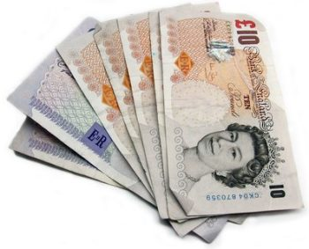
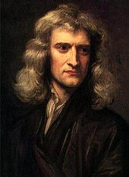
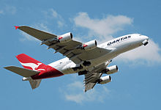
Economy: United Kingdom
Partially regulated market economy
Interest rates are set each year
Sixth largest economy in the world
3rd largest in Europe after Germany and France
Currency is the pound sterling (£)
GDP = $36,120
7.6% unemployment
unemployment rate among 18 to 24-year-olds had risen to 20.3%
Largest financial centre (paired with NYC and Tokyo)
Exports/Industries:
Motor industry, civil & defense aircraft, Airbus, Rolls-Royce, chemicals, pharmaceutical, Tourism (6th major tourist attraction in the world), banking, insurance
Imports 40% of its food supplies

Slide 10
Fun Facts: Japan
Some 250 high-speed trains connect major cities
Japanese trains are known for their punctuality
173 airports in Japan
largest domestic airport, Haneda Airport, is 2nd busiest in Asia
84–96 percent of Japanese follow Buddhism or Shinto
Writing uses Kanji (Chinese characters) and two sets of kana (syllabaries based on simplified Chinese characters
Education - 15 year olds are ranked 6th best in the world in overall knowledge and skills

Slide 11
Health care is provided by national and local governments
Culture combines influences from Asia, Europe and North America
Sumo is considered Japan's national sport
Martial arts include judo, karate, and kendo
Western sports were introduced in Japan after 1868
Japan hosted the Summer Olympics in Tokyo in 1964

Slide 12
Fun Facts: United Kingdom
Royal Greenwich Observatory in London is defining point of the Prime Meridian (0)
The coastline of Great Britain is 11,073 mi long
U.K. is connected to continental Europe by the Channel Tunnel
At 31 mi (24 mi underwater) is the longest underwater tunnel in the world.
London is the most visited city in the world with 15.6 million visitors (2nd-placed Bangkok (10.4) and 3rd-placed Paris (9.7)

Slide 13
The U. K. has sovereignty over seventeen territories which do not form part of the U.K. itself
14 British Overseas Territories: Anguilla, Bermuda, British Antarctic Treaty, British Ocean Territory, British Virgin Islands, Cayman Islands, Falkland Islands, Gibraltar, Montserrat, Saint Helena, Ascension and Tristan da Cunha, the Turks and Caico Islands, Pitcairn Islands, South Georgia and the south Sandwich Islands, and the Sovereign Base Areas on Cyprus
Three Crown Dependencies
British claims in Antarctica are not universally recognized
Overseas territories encompass an approximate land area of 667,018 square miles
Remnants of the British Empire
several have specifically voted to remain British territories.

Slide 14
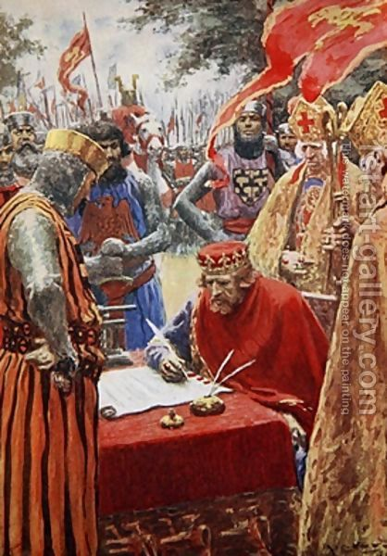
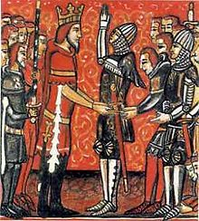
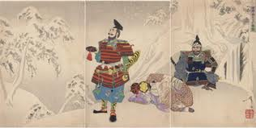
Feudalism: a worldwide phenomenon
System for ordering society around relationships derived from the holding of land in exchange for service or labor.
Legal and military customs
Flourished between the ninth and fifteenth centuries

Slide 15
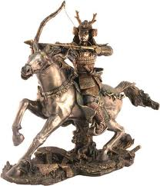
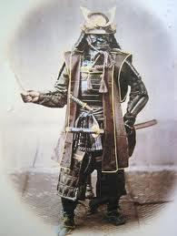
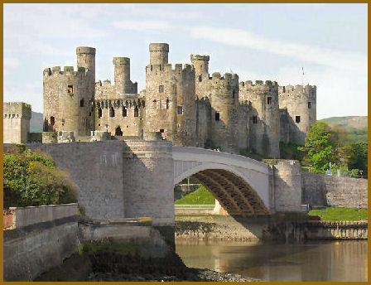
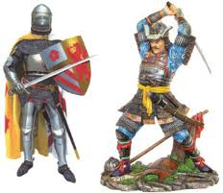
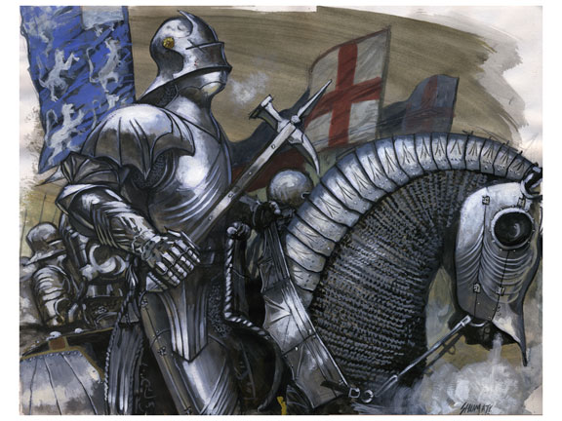
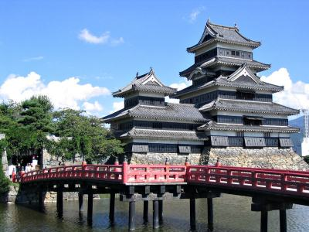
Same system; halfway around the world
Japan
Europe
Emperor
Shogun
Samurai
Bushido
Farmers/Craftsmen
Merchants/Slaves
Gaijin
King
Lords
Knights
Chivalry
Merchants
Farmers/Peasants/Peons
Slaves

