Slide 1
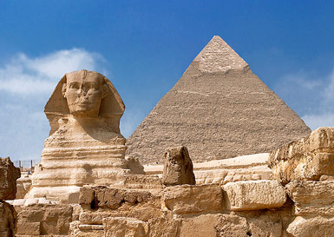
Intro to SWACANA (Southwest Asia, Central Asia, and North Africa)
Byvik
WG 4

Slide 2
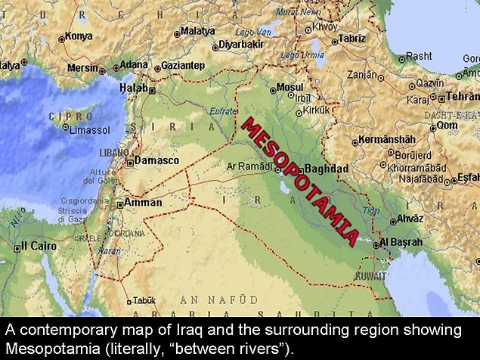
“Cradle of Civilization”
“Middle East” refers to Northern Africa and Southwest Asia
The oldest civilizations in human history developed in the Middle East
Early civilizations in Mesopotamia between the Tigris and Euphrates Rivers in today’s Iraq
Current Significance
The region is significant to the United States for two major reasons:
Religion
Natural resources (oil)

Slide 3
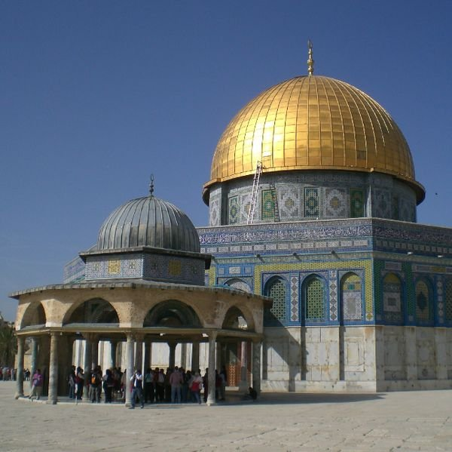
History:
Religion
Three major religions originated in Middle East:
Judaism, Christianity, Islam
All from Abrahamic tradition
Middle East today:
Arabic (language)
Muslim (religion)
Mixture of cultures causes tension
Because of all the different cultures and the religious significance of the region, there has been serious conflict for thousands of years.

Slide 4
Many of the Islamic countries do not like Western ideas because of their traditional religious beliefs.
Women’s role in society
“infidels” in Muslim lands
Separation of church and state
Many others in the Middle East feel that the modern countries take advantage of them for their natural resources (oil).

Slide 5
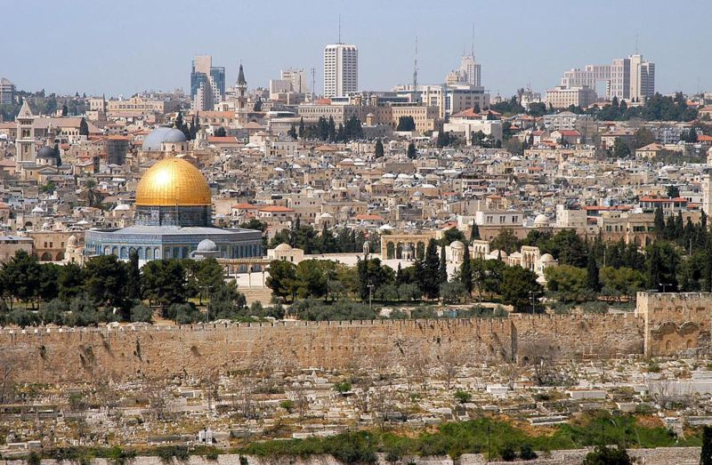
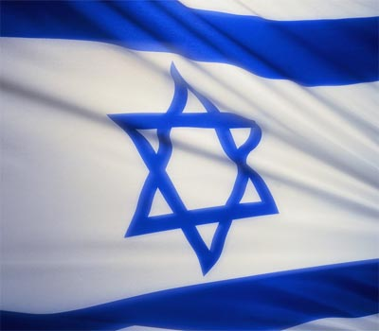
History:
Palestine is a major area of conflict:
Jews believe that this land was given to them by God (the Promised Land).
Palestinians (Arabs) have also lived there for thousands of years.
Most of the world today calls it Israel
The city of Jerusalem lies at the heart of the conflict. It is sacred to Jews, Christians, and Muslims.
Dome of the Rock (Islam)
Western Wall (Judaism)
Church of Holy Sepulcher, Bethlehem (Christianity)

Slide 6
Several wars and peace agreements in the 20th century
United States has usually favored Israel
Arab states have usually favored the Palestinians
Many in the Middle East hate the United States for supporting Israel

Slide 7
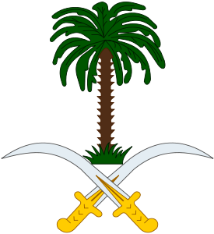
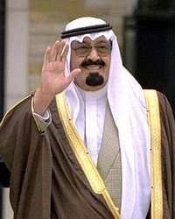
Governments
Few democracies
Many dictatorships or theocracies
Governments typically do not protect human rights
Some have supported terrorism
King Abdullah bin Abdul-Aziz of Saudi Arabia

Slide 8
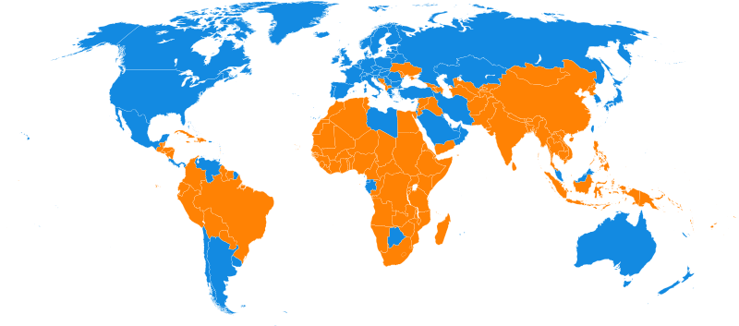
Wealth
Countries with above average per capita GDPs:
Kuwait: $22,100
United Arab Emirates: $29,100
Qatar: $26,000
Israel: $22,200
Unequal income distribution
Developing Countries
Yemen: $800
Egypt: $4,400
Iraq: $3,400

Slide 9
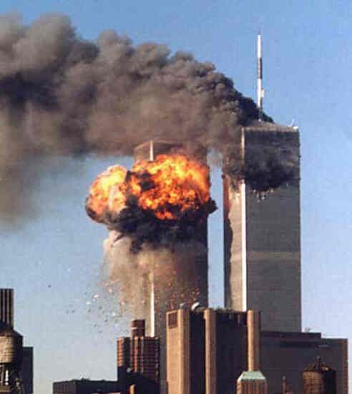
Terrorism
Terrorism is not at all a new idea
Many in the United States didn’t know much about it until the World Trade Center attacks in 2001.
Terrorism has been around for centuries
Islamic extremists use these methods to try to achieve their goals
Islam is a peaceful religion, but terrorists often convince people that their actions are supported by the Koran (Islamic “Bible”).

Slide 10
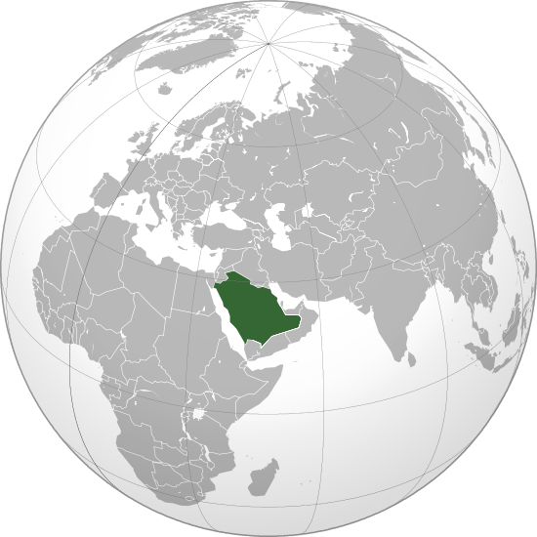
Size
Land Size
Algeria (2.3 mil km)(11th)
Saudi Arabia (2.1 mil km) (14th)
Libya (1.7 mil km) (17th)
Population
Iran: 68 million (17th)
Turkey: 69.7 million (18th)
Egypt: 77.5 million (15th)

Slide 11
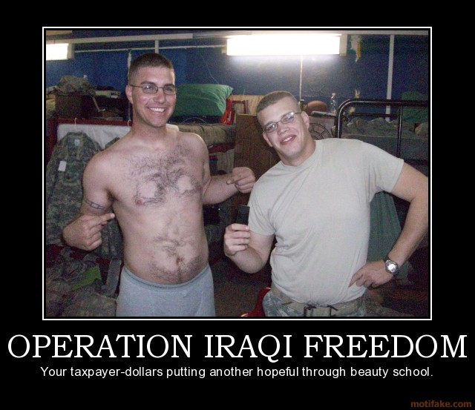
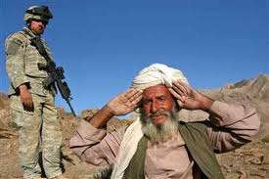
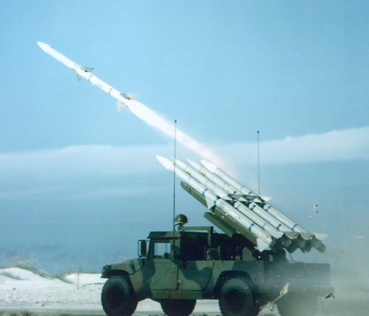
Recent conflicts
Wars between Israel and Arab countries
United States intervention (Gulf War, current situation in Iraq, etc.)
Cycle of violence

Slide 12
Middle East Today
Today, the countries of the Middle East reflect the vast differences in cultures and beliefs of its people, and the differences in the physical resources of the lands.
Much of the oil used by modern countries comes from the Middle East.
Countries with oil are wealthier
Countries without much oil are usually very poor
Oil-Rich Countries:
Saudi Arabia
Kuwait
United Arab Emirates
When there is trouble in the Middle East, the oil supply becomes uncertain, and prices

