Slide 1
NAFTA Pro’s and Cons
PRO
Jobs and factories have been shipped to Mexico, but supplier is not shipped. In other words, US manufacturers continue to purchase from their suppliers in US. Unlike jobs and factories exported to China, US suppliers connections are not cut.

Slide 2
NAFTA Pro’s and Cons
CON
Factories are relocated, and jobs are cut.

Slide 3
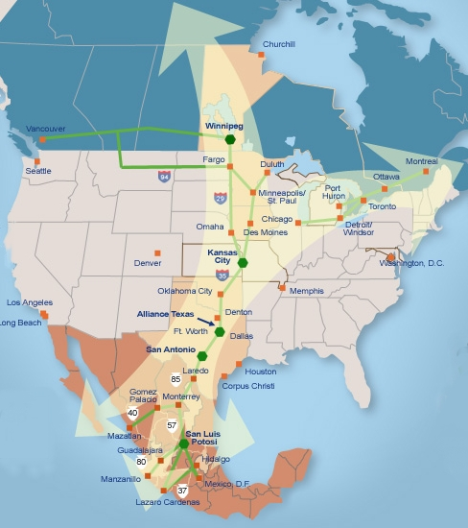
NAFTA Pro’s and Cons
PRO
Mexicans benefit from this treaty, since more jobs are created for low income people, and help build the Mexican economy.

Slide 4
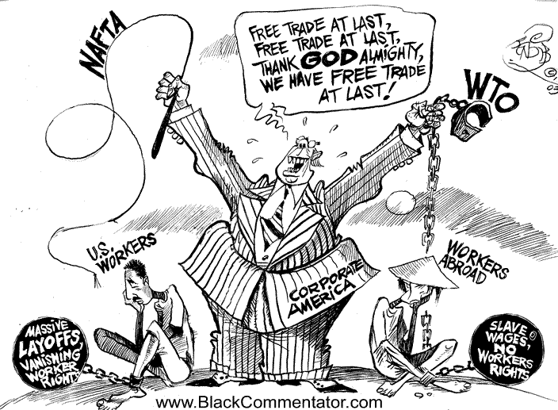
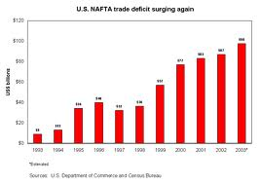
NAFTA Pro’s and Cons
CON
The opposite effect is that Americans are losing their jobs, increase US trade deficit.

Slide 5
NAFTA Pro’s and Cons
PRO
NAFTA brought in a flood of foreign investment and contributed to a 24% rise in Mexico's per capita income.

Slide 6
NAFTA Pro’s and Cons
CON
The pact has destroyed Mexico's small farmers, and brought in an influx of subsidized U.S. food imports

Slide 7
NAFTA Pro’s and Cons
PRO
Its mission is to increase number of Mexican jobs, increase standard of living, and thereby decrease the illegal Mexican immigrants entering US

Slide 8
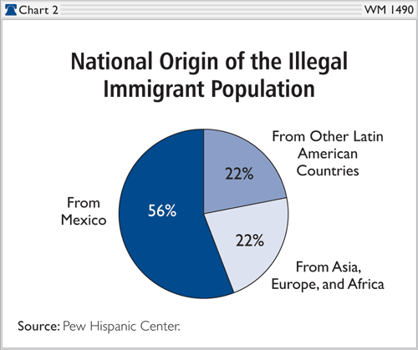
NAFTA Pro’s and Cons
CON
Data has shown NAFTA to be ineffective in stemming the tide of illegal Mexican immigrants entering the US to find jobs.

Slide 9
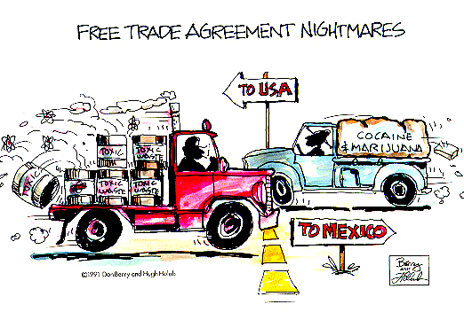
NAFTA Pro’s and Cons
PRO
US companies near the border are gaining positive results from NAFTA

Slide 10
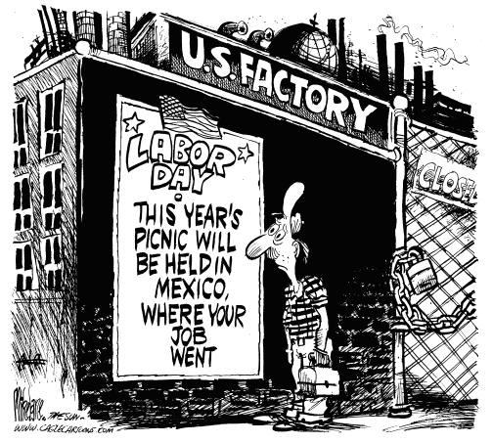
NAFTA Pro’s and Cons
CON
US companies away from the border are gaining negative results from NAFTA, notably jobs

Slide 11
NAFTA Pro’s and Cons
PRO
NAFTA'S goal is to reduce tariffs among Mexico, Canada, and the United States over a period of years, making it easier to trade goods across national borders, and increasing economic efficiency in North America. It deserves the strong support of all those who believe in liberty and free markets.

Slide 12
NAFTA Pro’s and Cons
CON
Environment is seriously jeopardized as pollution will increase

